Slide 1


Slide 2
Review Cascoding

Slide 3
7.2. The Basic Gain Cell
Two types of basic gain cells exist:
Common-source (CS)
Common-emitter (CE)
Both are loaded with constant-current source.
This is done because of difficulties associated with fabrication of exact resistances.
It also facilitates increased gain.
These circuits are referred to as current-source loaded / active loaded.

Slide 4
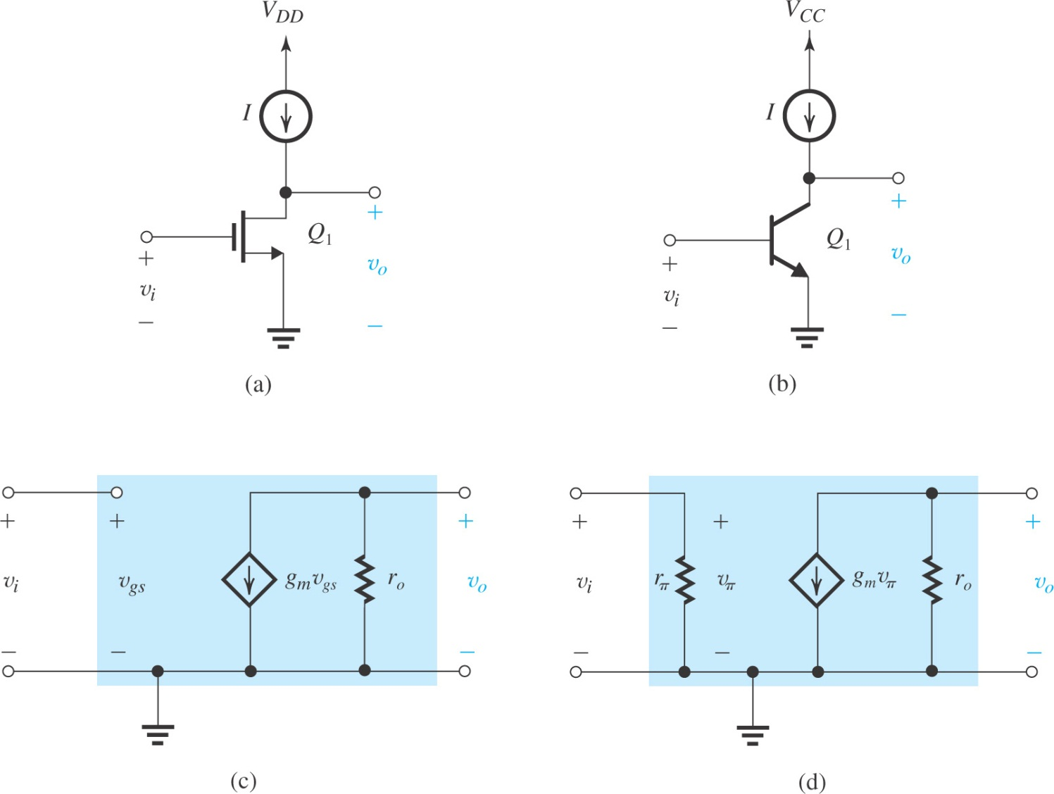
current-source- or active-loaded common-source amplifier
current-source- or active-loaded common-emitter amplifier

Slide 5
7.2. The Basic Gain Cell
Both formula for MOS and BJT seem same , but are actually different

Slide 6
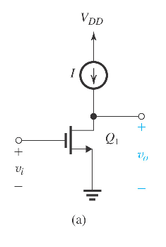
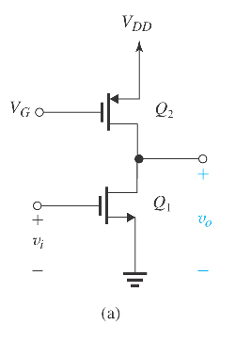
Effect of the Output Resistance of the Current-Source Load
The current-source load of the CS amplifier in Figure (left) can be implemented using a PMOS transistor biased in the saturation region to provide the required current I, as shown in Figure (right)

Slide 7
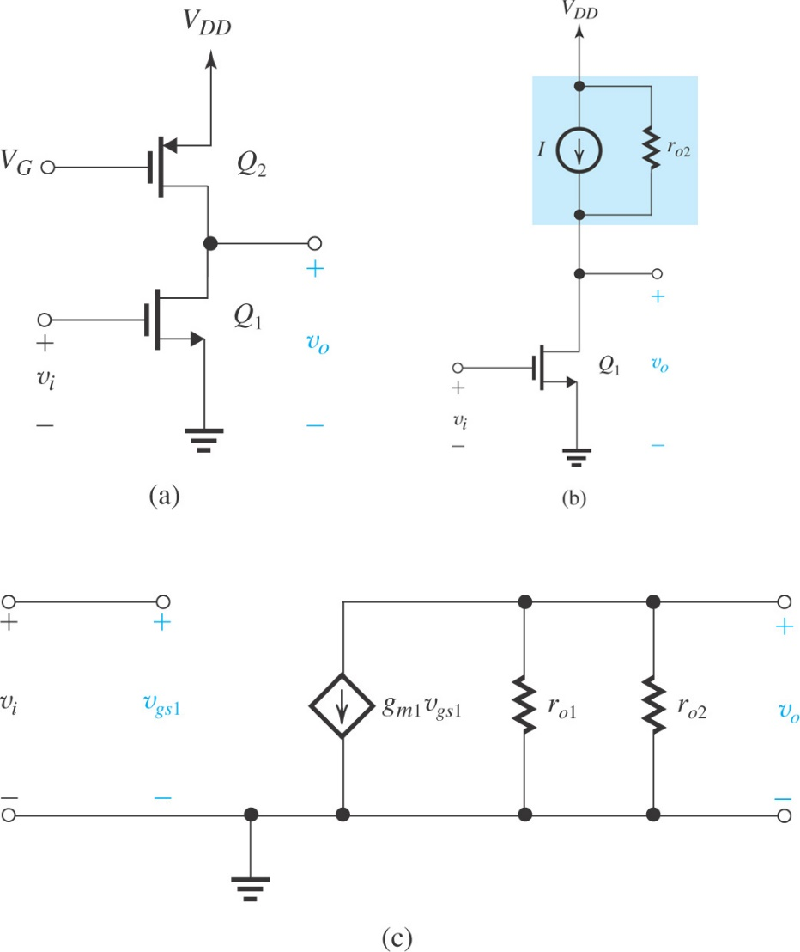
Effect of the Output Resistance of the Current-Source Load
(a): The CS amplifier with the current-source load implemented with a
p-channel MOSFET Q₂ ;
(b) the circuit with Q₂ replaced with its large-signal model; and
(c) small-signal equivalent circuit of the amplifier.

Slide 8
Conclusion
Simple current-source loads reduce the gain realized in the basic gain cell because of their finite resistance (usually comparable to the value of r_{o} of the amplifying transistor).

Slide 9
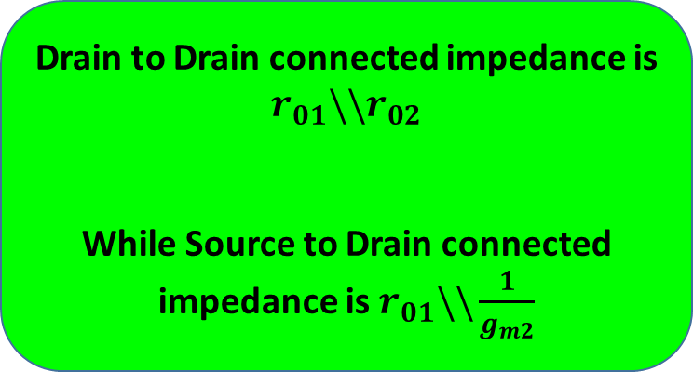
7.2.3. Effect of the Output Resistance of the Current-Source Load
The current-source load of the CS amplifier in Figure on left can be implemented using a PMOS transistor biased in the saturation region to provide the required current I, as shown in Figure on right.
Why PMOS as current source for NMOS amplifier and vice versa ?
Drain to Drain connected impedance is $r_{01}\backslash \backslash r_{02}$
While Source to Drain connected impedance is $r_{01}\backslash \backslash \frac{1}{g_{m2}}$

Slide 10
Some basic concepts of gain/input & output impedances of discrete amplifiers

Slide 20
Back to Topic from text book

Slide 21
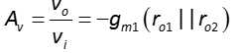
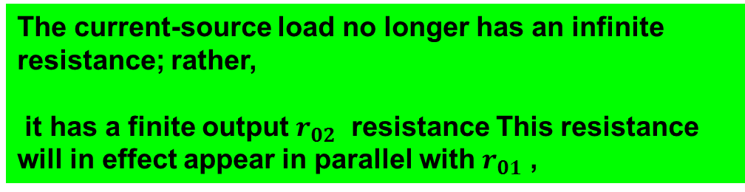
What was the Effect of the Output Resistance of the Current-Source Load
The current-source load no longer has an infinite resistance; rather,
it has a finite output $r_{02}$ resistance This resistance will in effect appear in parallel with $r_{01}$ ,
Gain Reduces to
And if

Slide 22
Problem :
The practical (non-ideal) constant-current source (active-load) has reduce the intrinsic gain of my basic gain cell (CS or CE)

Slide 23
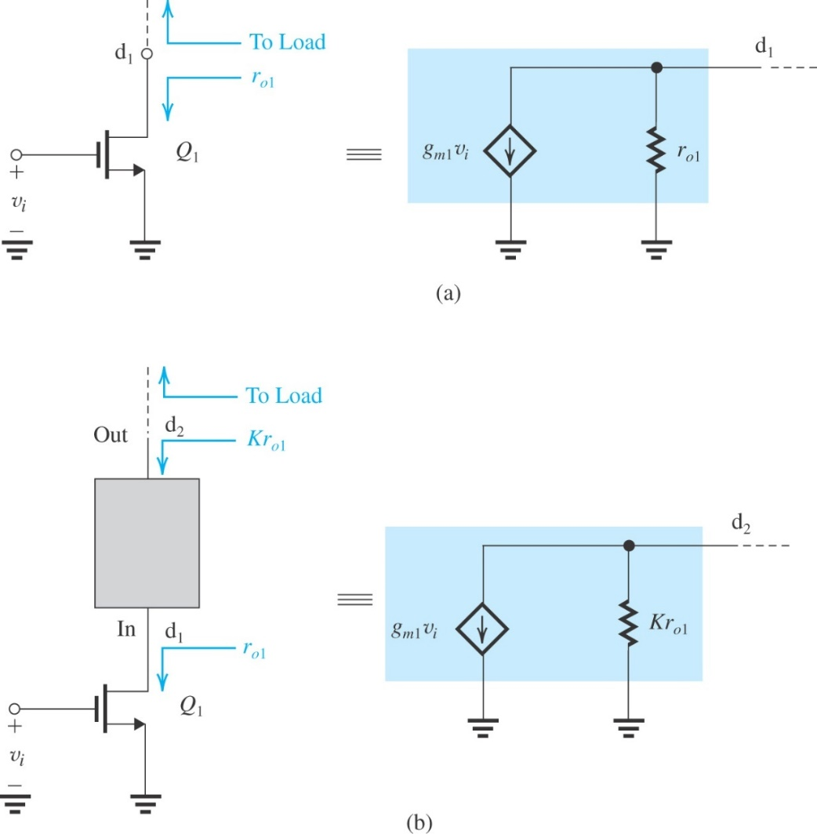
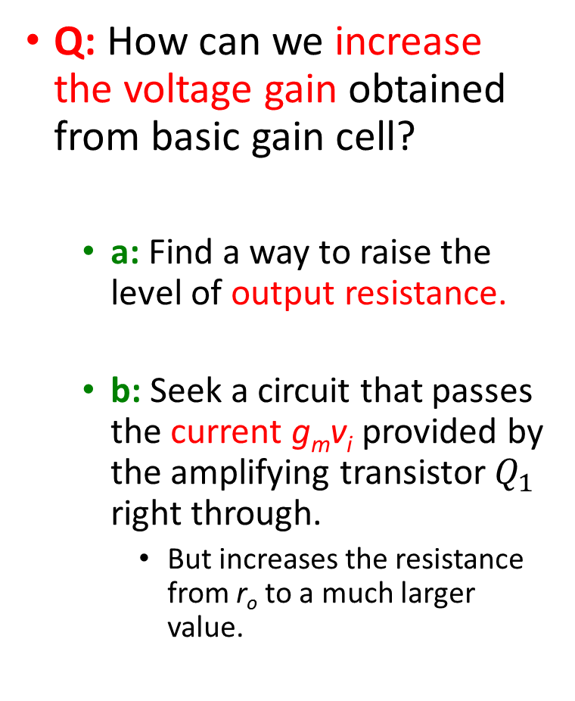
Increasing the Gain of the Basic Cell
Q: How can we increase the voltage gain obtained from basic gain cell?
a: Find a way to raise the level of output resistance.
b: Seek a circuit that passes the current g_{m}v_{i} provided by the amplifying transistor $Q_{1}$ right through.
But increases the resistance from r_{o} to a much larger value.
To increase the voltage gain realized in the basic gain cell, shown as a black box is connected between d₁ and the load

Slide 24
Increasing the Gain of the Basic Cell
The black box of Figure is actually a current buffer
Two important comments:
It is not sufficient to raise output resistance of amplifying transistor only. We will have to raise the output resistance of the active load as well
Placing CG (or a CB) circuit on top of the CS (or CE) amplifying transistor to implement the current-buffering action is called cascoding.

Slide 25
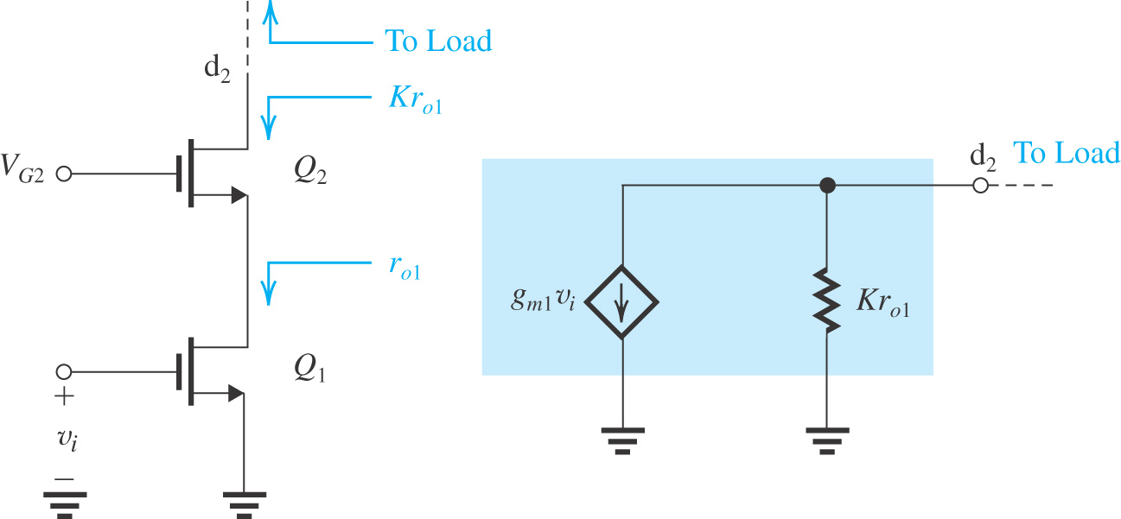
The Cascode Amplifier
Cascoding refers to the use of a transistor connected in the common-gate (or the common-base) configuration to provide current buffering for the output of a common-source (or a common-emitter) amplifying transistor
The current-buffering action is implemented using a transistor Q₂ connected in the CG configuration. Here V_{G2} is the dc bias voltage.
Previous
Thus, the cascode transistor passes the current to the output node while raising the resistance level by a factor K. We will derive an expression
for K.

Slide 26
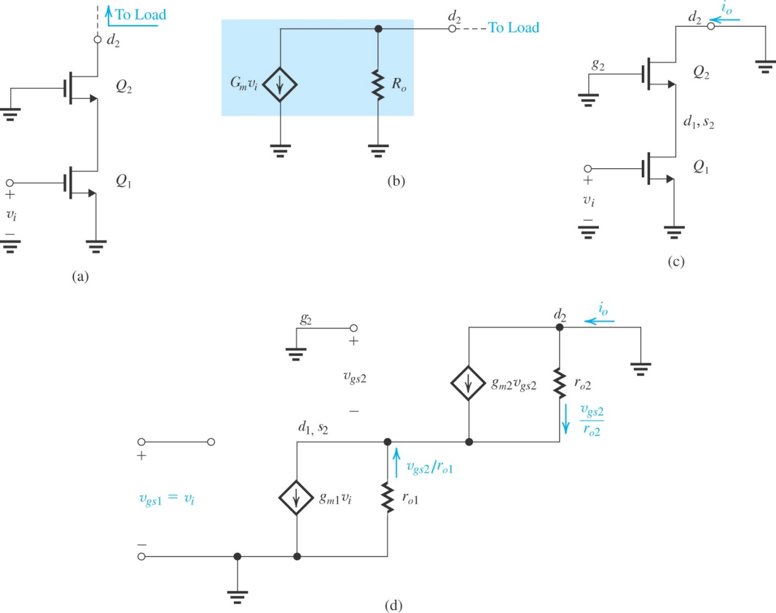
The MOS Cascode
A MOS cascode amplifier prepared for small-signal calculations
(b) output equivalent circuit of the amplifier in (a);
(c) the cascode amplifier with the output short-circuited to determine G_{m};
(d) equivalent circuit of the situation in (c).

Slide 27
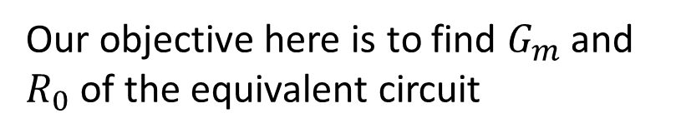
The MOS Cascode
Our objective here is to find $G_{m}$ and $R_{0}$ of the equivalent circuit

Slide 28

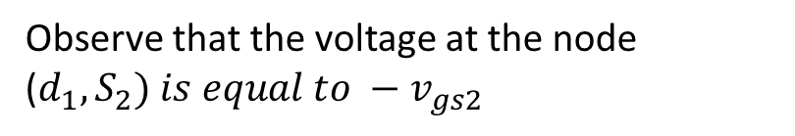
The MOS Cascode
Observe that the voltage at the node ($d_{1}, S_{2}) is equal to −v_{gs2}$
Writing node equation for this node
Here we proved that currents of two transistors are same
1

Slide 29

Here we proved that this current is also equal to output current , proving that
$G_{m}=g_{m1}$
As
And thus

Slide 30
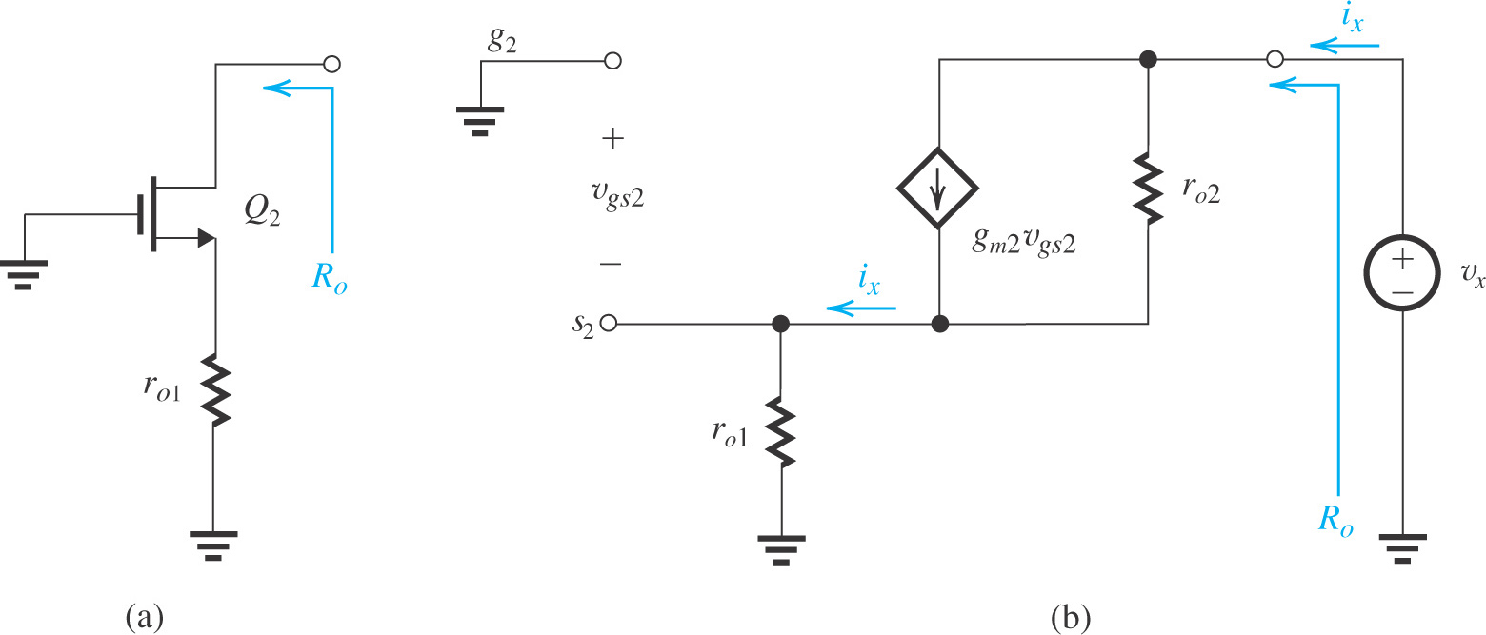
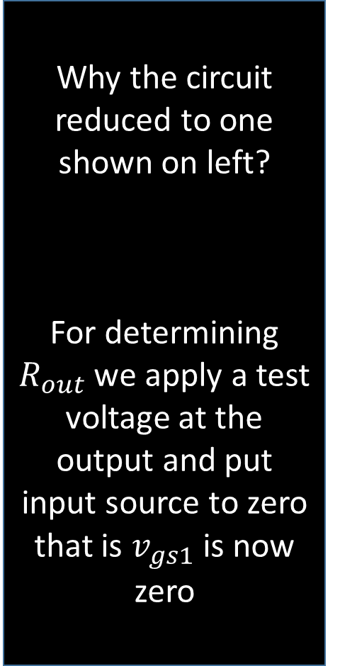
Determining the output resistance of the MOS cascode amplifier.
Why the circuit reduced to one shown on left?
For determining $R_{out}$ we apply a test voltage at the output and put input source to zero that is $v_{gs1}$ is now zero
The output resistance
can be obtained as

Slide 32
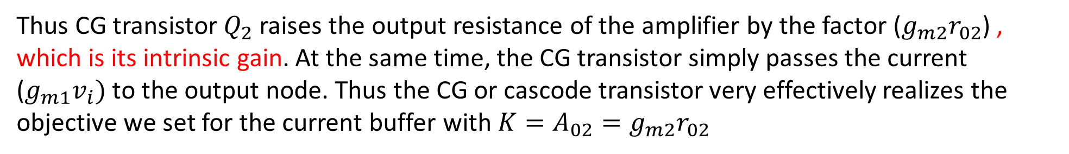

Thus CG transistor $Q_{2}$ raises the output resistance of the amplifier by the factor ($g_{m2}r_{02}$) , which is its intrinsic gain. At the same time, the CG transistor simply passes the current ($g_{m1}v_{i})$ to the output node. Thus the CG or cascode transistor very effectively realizes the objective we set for the current buffer with $K=A_{02}=g_{m2}r_{02}$
Voltage Gain:
If the cascode amplifier is loaded with an ideal constant-current source, the voltage gain realized can be found from the equivalent circuit as on the right
Thus cascading results in increasing the gain magnitude from $A_{0} to A_{0}^{2}$

Slide 33
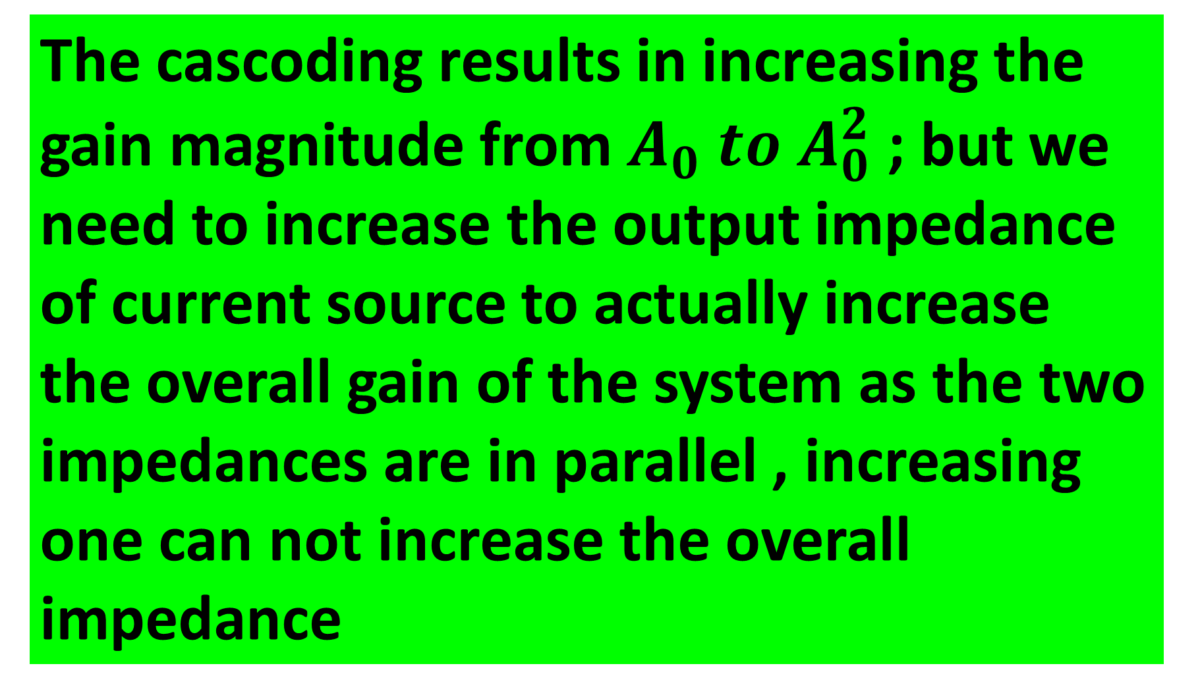
The cascoding results in increasing the gain magnitude from $A_{0} to A_{0}^{2}$ ; but we need to increase the output impedance of current source to actually increase the overall gain of the system as the two impedances are in parallel , increasing one can not increase the overall impedance

Slide 34
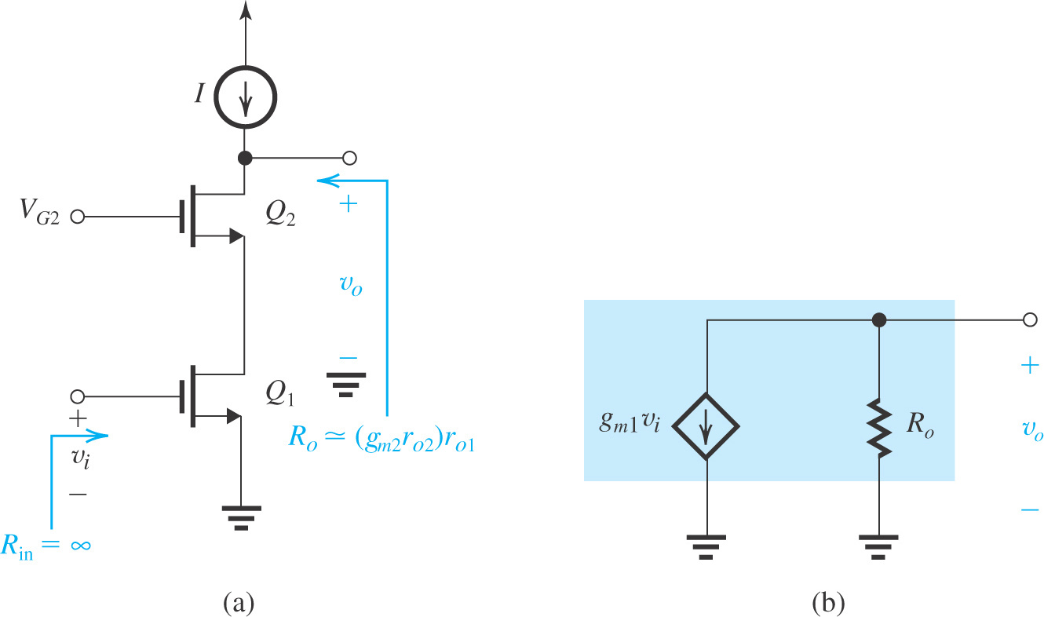

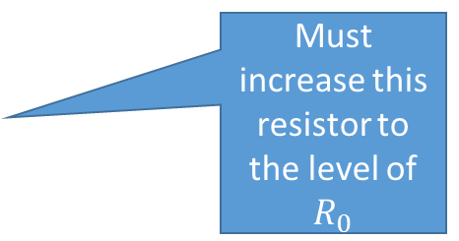
Cascoding current source as well
Non Ideal current source
This current source is not ideal that is it has a finite impedance which is now in parallel with $R_{0}$
Must increase this resistor to the level of $R_{0}$
Cascode Amplifier

Slide 35
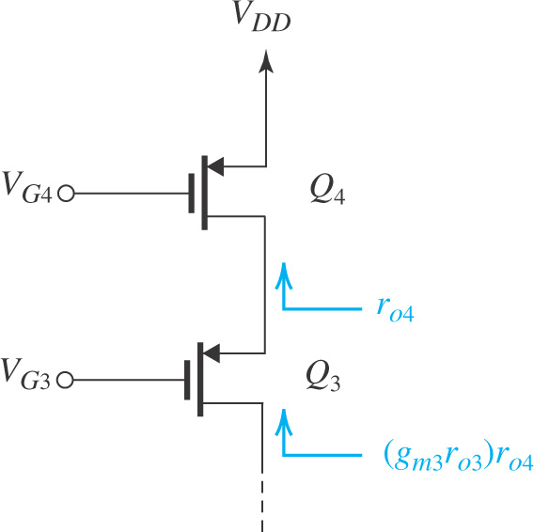
Cascoding current source as well
Employing a cascode transistor Q₃ to raise the output resistance of the current source Q₄.
Cascoding may be employed to raise the output resistance of the current-source load as shown in Figure .
Here, Q₄ is the current-source transistor and Q₃ is the CG cascode transistor.
Voltage V_{G3} and V_{G4} are the dc bias voltages.
The cascode transistor (Q₃) multiplies the output resistance of Q₄, r_{o4} to provide an output resistance for the cascode current source of…
R_{o} = (g_{m3}r_{o3})r_{o4}

Slide 36
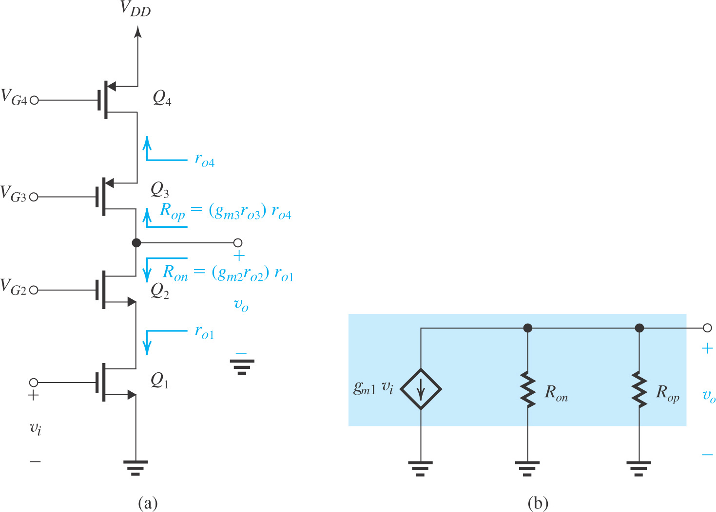
Combining a cascode amplifier with a cascode current source results in the circuit shown in Figure
A cascode amplifier with a cascode current-source load.

Slide 37
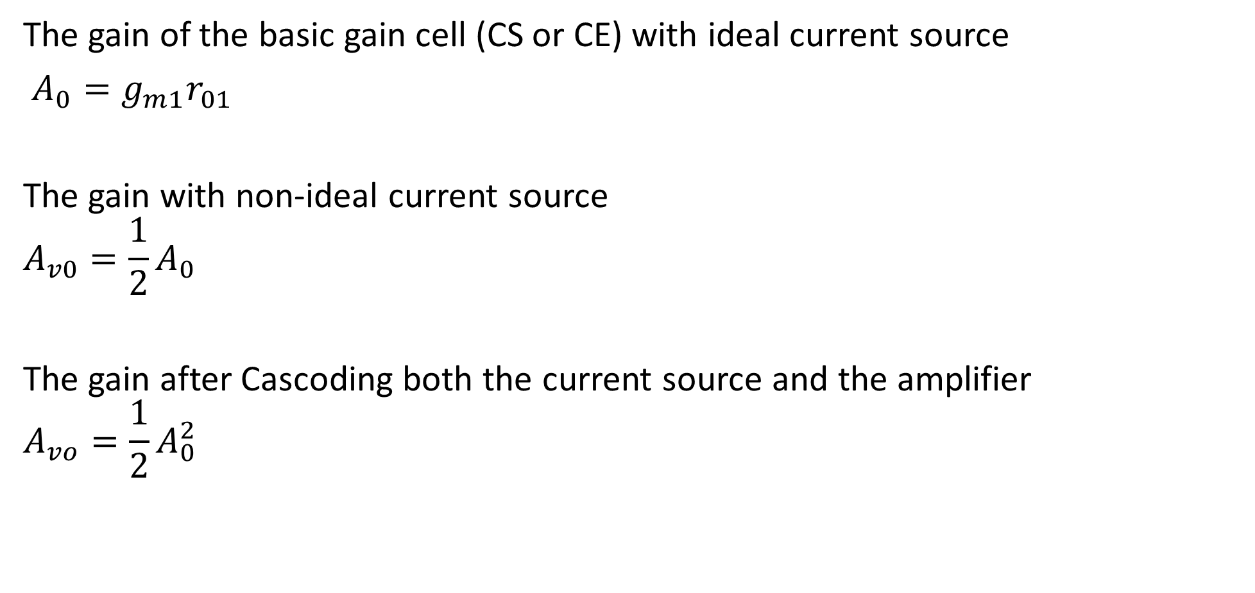
Summary
The gain of the basic gain cell (CS or CE) with ideal current source
$A_{0}=g_{m1}r_{01}$
The gain with non-ideal current source
$$A_{v0}=\frac{1}{2}A_{0}$$
The gain after Cascoding both the current source and the amplifier
$$A_{vo}=\frac{1}{2}A_{0}^{2}$$

Slide 38
Double Cascoding
If still a higher output resistance and correspondingly higher gain are required, it is still possible to add another level of cascoding
Observe that Q₃ is the second cascode transistor, and it raises the output resistance by (g_{m3}r_{o3}).
For the identical transistor the output resistance will be ${\left(g_{m}r_{0}\right)}^{2}r_{0}$
And the voltage gain assuming ideal current source load will be ${\left(g_{m}r_{0}\right)}^{3}$ or $A_{0}^{3}$
Ofcourse we have to generate another DC bias voltage for the second cascode transistor $Q_{3}$

Slide 39
Disadvantage of Multiple cascoding

Slide 40
The Folded Cascode
To avoid the problem of stacking a large number of transistors across a low-voltage power supply, one may use a PMOS transistor for the cascode device
This provides an alternative to the design proposed in previous section.

Slide 41
Home assignment : not be be submitted
Solve and understand this example

Slide 42
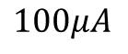
$$100μA$$

Slide 45
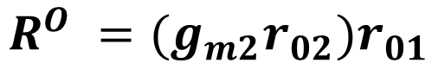
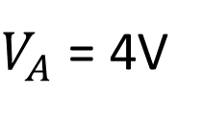
$$R^{O} =(g_{m2}r_{02}{)r}_{01}$$
$g_{m2}r_{o2 }= \frac{2×V_{A}}{V_{OV}}$ = 40
Therefore
$V_{A}$ = 4V
$$V_{A}^{/} ×L = \frac{4V}{{5V}/{μm}}=0.8 μm$$

Slide 46
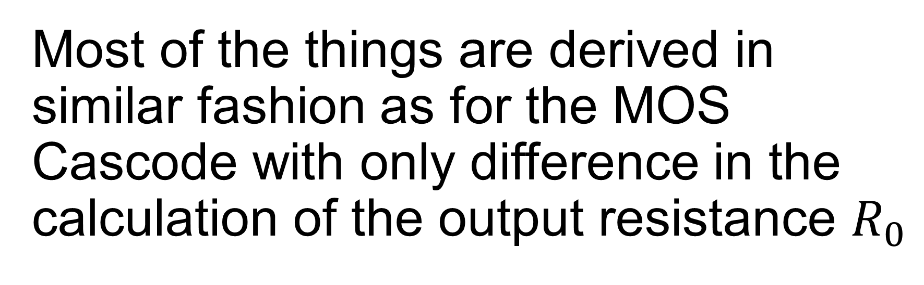
The BJT Cascode
Most of the things are derived in similar fashion as for the MOS Cascode with only difference in the calculation of the output resistance $R_{0}$

Slide 47
Figure shows the BJT cascode amplifier with an ideal current-source load.
Objective is to determine the parameters G_{m} and R_{o} of the equivalent circuit
Voltage V_{B2} is a dc bias voltage for the CB cascode transistor Q₂

Slide 48
As in case of MOS cascode, G_{m} is the short-circuit transconductance and can be determined from the circuit in Figure

Slide 49
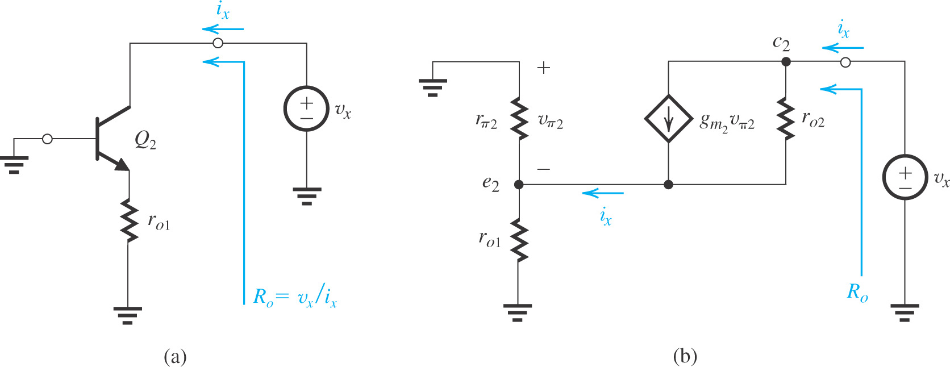

Determining the output resistant R_{o} of the BJT cascode amplifier.
Here $−v_{π2}=i_{x}\left(r_{01}\backslash \backslash r_{π2}\right)$
Next we write loop equation around $c_{2} −e_{2} ground loop$
Observe the difference in small signal model for calculating $R_{0}$ for MOS and BJT
Double cascoding with a BJT would not be useful (Ro won’t be further raised by Double cascoding)

Slide 50
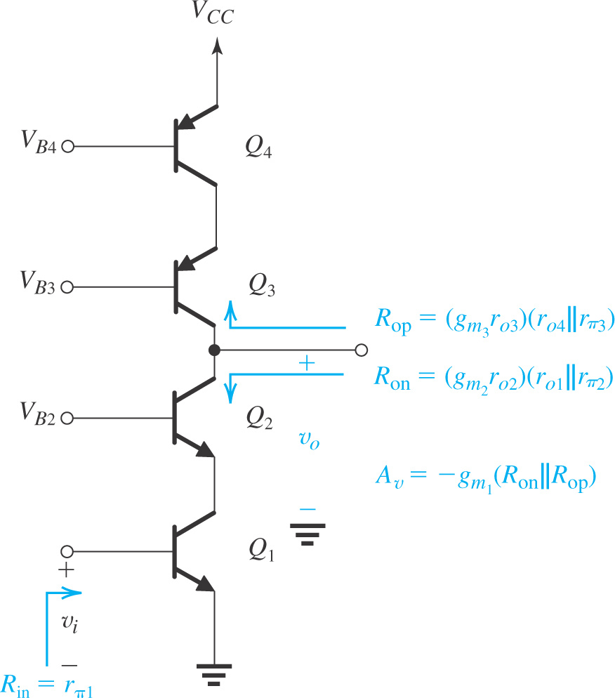
Determining the output resistant R_{o} of the BJT complete cascode amplifier
.

Slide 51
Current sources, Mirrors & current steering
Lecture

Slide 52
Chapter 7
Amplifier
CS
CE
Biasing source
MOS Mirrors
Improvements in Mirrors
Other transistor configurations
BJT Mirrors
Cascoding
Cascoding

Slide 53
7.4. IC Biasing – Current Sources, Current Mirrors, and Current-Steering Circuits
Biasing in integrated-circuit design is based on the use of constant-current sources.
On an IC chip with a number of amplifier stages, a constant dc current (reference current) is generated at one location and is then replicated at various other locations for biasing.
This is known as current steering.
This approach has the advantage that the effort expended on generating a predictable and stable reference current need not be repeated.

Slide 55
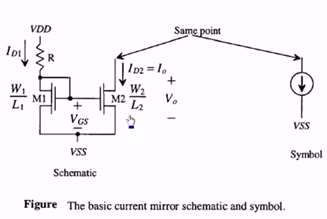

Slide 56
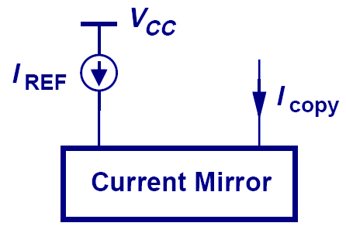
Concept of Current Mirror
A current mirror would mirror current flowing into the left channel , into the right channel
The motivation behind a current mirror is to sense the current from a “golden current source” and duplicate this “golden current” to other locations.

Slide 57
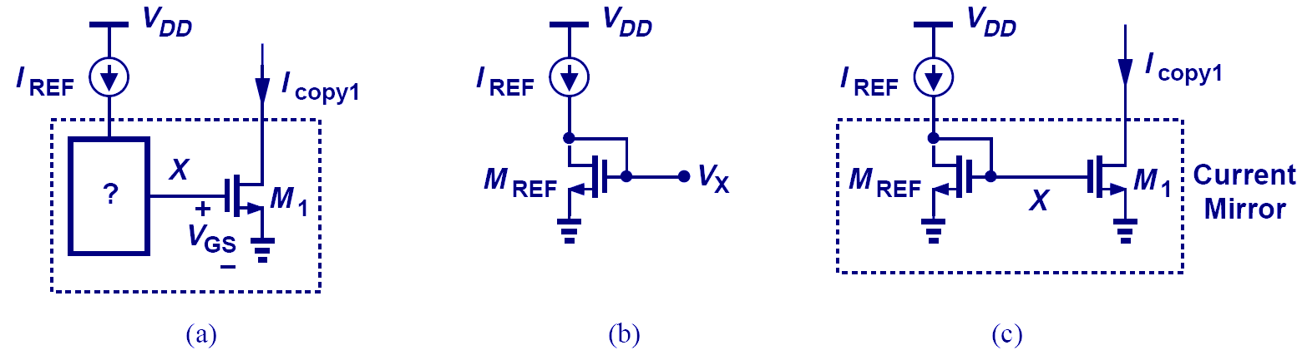
MOS Current Mirror
The concept of current mirror applied to MOS transistors

Slide 58
BASIC PRINCIPLE
The current mirrors uses the principle that if the gate –source potential of two identical MOS transistors are equal then the current flown through their Drain terminals should be the same
NMOS current mirrors are used as current sinks and PMOS current mirrors are used as current sources
There is variety of current mirror circuits available, each of them having their own advantages and applications

Slide 59
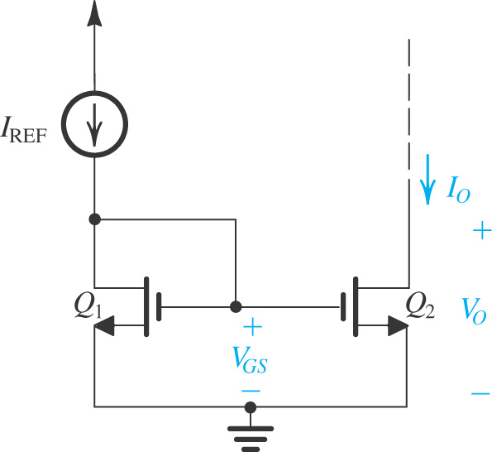
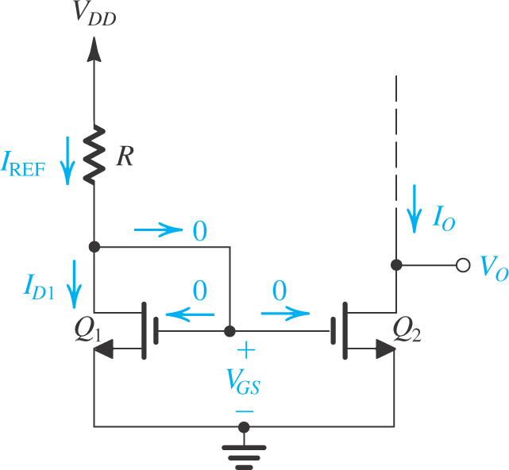
7.4.1. The Basic MOSFET Current Source
Circuit for a basic MOSFET constant-current source. For proper operation, the output terminal, that is, the drain of Q₂, must be connected to a circuit that ensures that Q₂ operates in saturation.
Basic MOSFET current mirror.

Slide 60
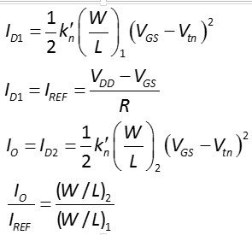
The Basic MOSFET Current Source

Slide 61
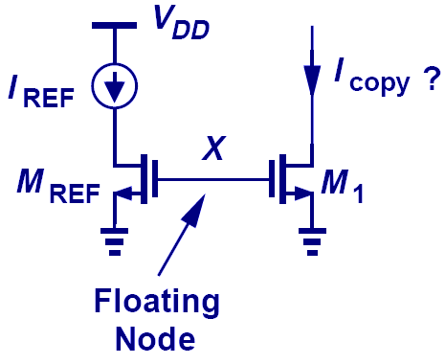
Bad MOS Current Mirror Example
This is not a current mirror since the relationship between V_{X} and I_{REF} is not clearly defined.
The only way to clearly define V_{X} with I_{REF} is to use a diode-connected MOS since it provides square-law I-V relationship.

Slide 62
Concept of Current Mirror
The motivation behind a current mirror is to sense the current from a “golden current source” and duplicate this “golden current” to other locations.

Slide 63
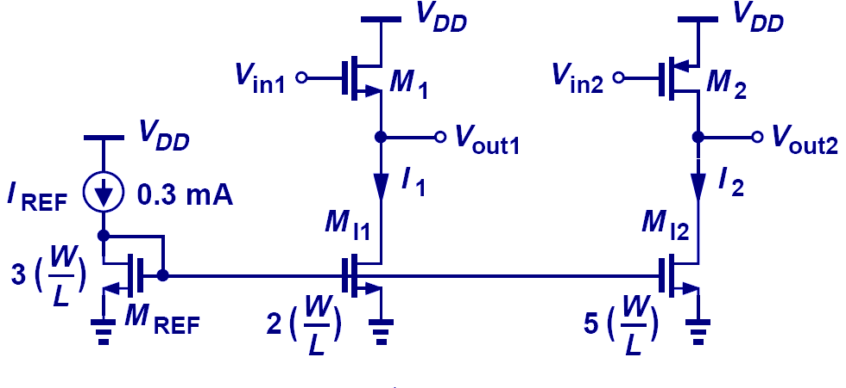
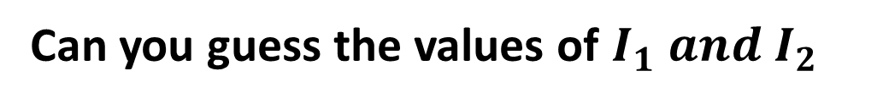
Example: Current Scaling
Can you guess the values of $I_{1} and I_{2}$
MOS current mirrors can also scale I_{REF} up or down (I₁ = 0.2mA, I₂ = 0.5mA).

Slide 64
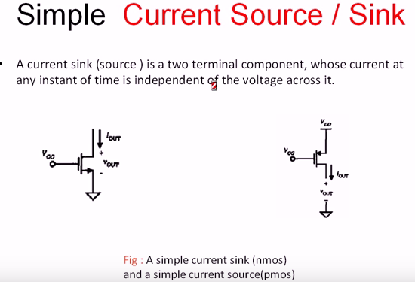
Basic concept of current source & sink

Slide 65
PMOS Source

Slide 66
NMOS –Sinks

Slide 67
Q1. Figure shows a PMOS CS stage using an NMOS current source load. Compute the voltage gain of the circuit
Acting as active load

Slide 68
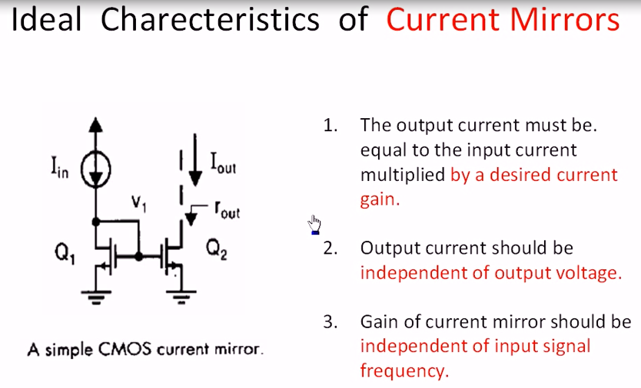

Slide 69

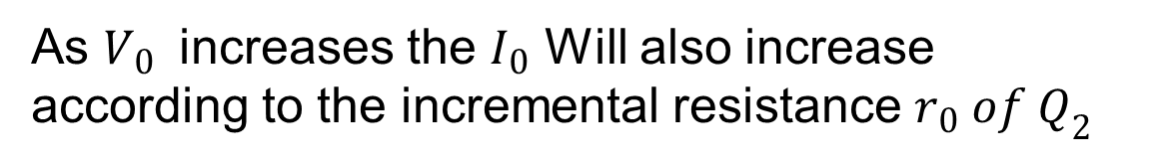
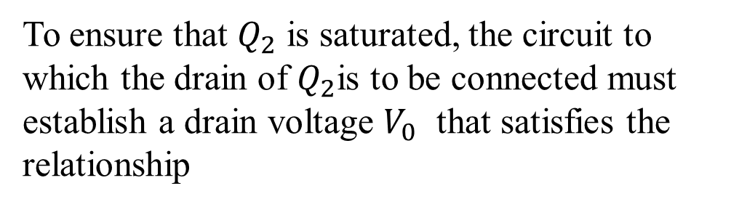
Effect of $V_{0} on I_{0}$
To ensure that $Q_{2}$ is saturated, the circuit to which the drain of $Q_{2}$is to be connected must establish a drain voltage $V_{0}$ that satisfies the relationship
channel-length modulation can have a significant effect on the operation of the current source.
As $V_{0 }$ increases the $I_{0}$ Will also increase according to the incremental resistance $r_{0} of Q_{2}$

Slide 70
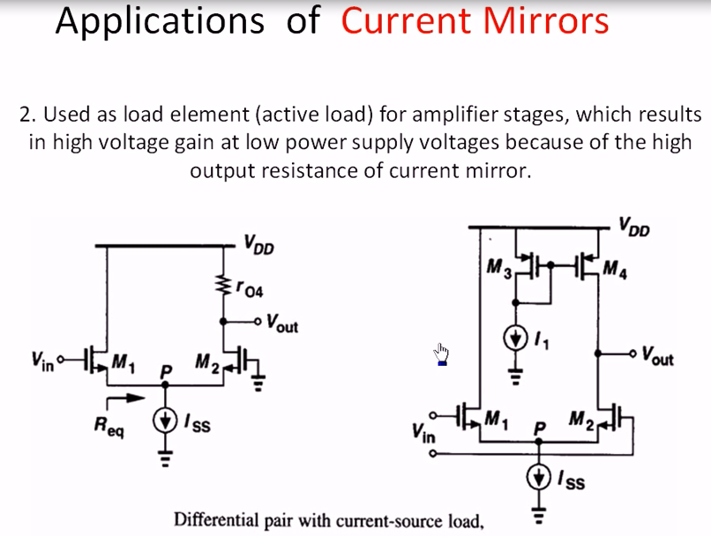

Slide 71
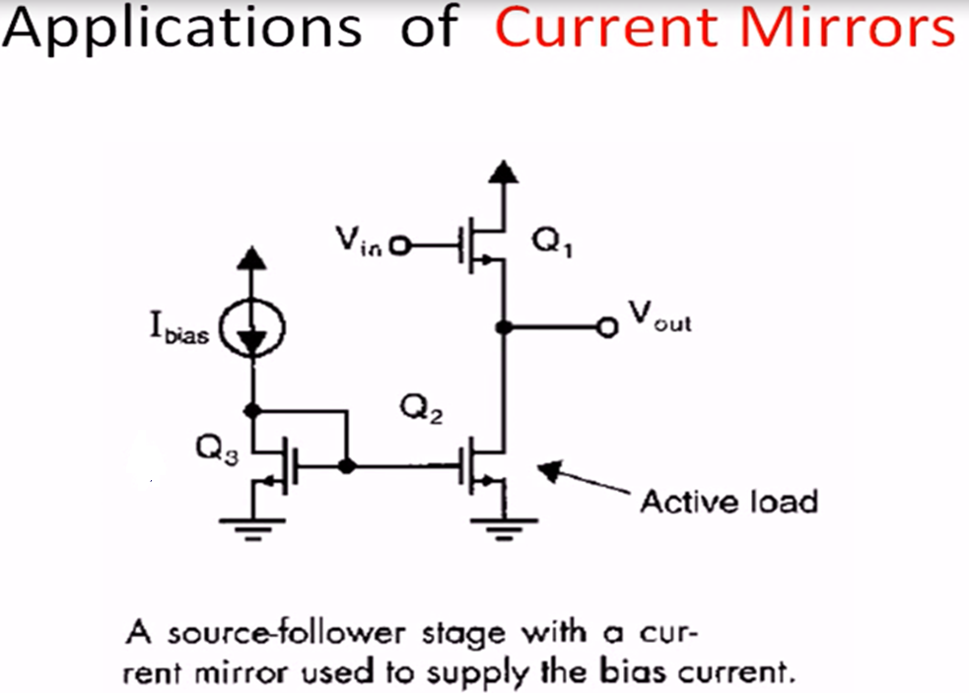

Slide 74

MOS Current-steering circuits
As mentioned earlier, once a constant current has been generated, it can be replicated to provide dc bias or load currents for the various amplifier stages in an IC.
$$Q_{1} and R$$
Determine Reference current
Q1, Q2 and Q3 FORMS TWO OUTPUT CURRENT MIRRORS
To ensure operation in the saturation region, the voltages at the drains of Q2 and Q3 are
constrained as

Slide 75
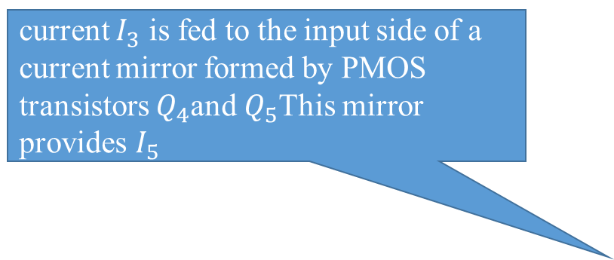
current $I_{3}$ is fed to the input side of a current mirror formed by PMOS transistors $Q_{4}$and $Q_{5}$This mirror provides $I_{5}$
Amplifier circuit
Amplifier circuit
while Q2 pulls its current I2, from a circuit , Q5 pushes its current I5 into a circuit . Thus Q5 is appropriately called a current source, whereas Q2 should more properly be called a current sink.

Slide 76
Question:
Compare the gains & output resistances of two stage CS amplifier vs that of a cascade amplifier

Slide 77
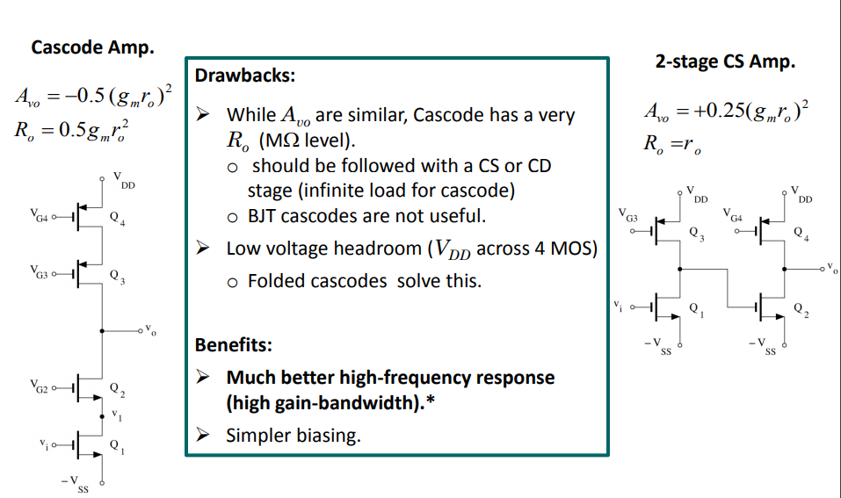
$$R_{O}=0.5r_{o}$$

Slide 78
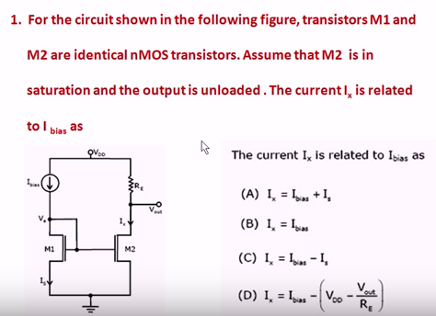

Slide 82
BJT-CURRENT MIRRORS
LECTURE NO 8

Slide 83
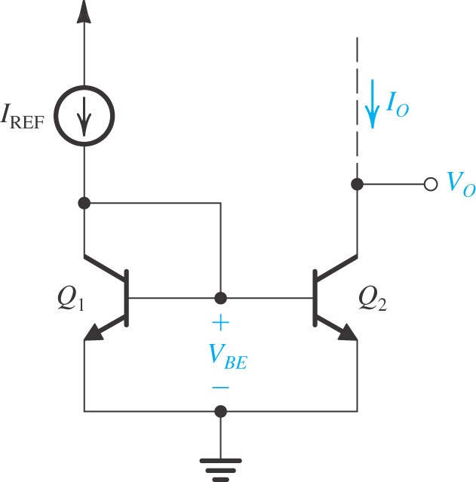
The basic BJT current mirror is shown
It works in a fashion very similar to the MOS mirror. However, with two important differences:
The non-zero base current of the BJT (or, equivalently, the finite β ) causes an error in the current transfer ratio of the BJT mirror .
The current transfer ratio is determined by the relative areas of the emitter-based junctions of Q₁ and Q₂.
Recall MOS Mirror

Slide 84
Case 1: β sufficiently high that we can neglect the base currents
To obtain a current transfer ratio other than unity, say m, we simply arrange that the area of the EBJ of Q2 is m times that of Q1 In this case

Slide 85
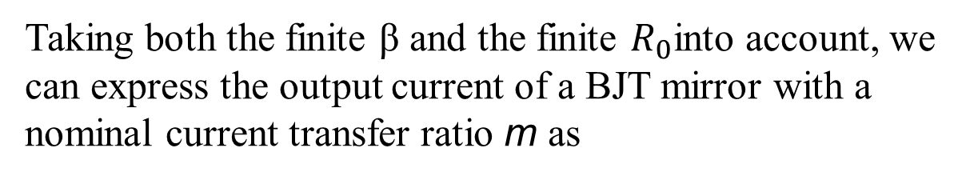
Case 2: the effect of finite transistor β on the current transfer ratio
Taking both the finite β and the finite $R_{0}$into account, we can express the output current of a BJT mirror with a nominal current transfer ratio m as

Slide 87
BJT –Current Steering
Source
Two parallel transistors so double current
Sink

Slide 89
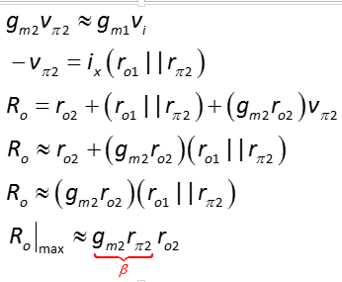
Equations Summary of BJT Cascode

Slide 90
BiMOS Cascodes
Certain advanced CMOS technologies allow the fabrication of bipolar transistors.
They permit the circuit designer to combine MOS and bipolar transistors in circuits that take advantage of the unique features of each.
The resulting technology is called BiCMOS.

Slide 91
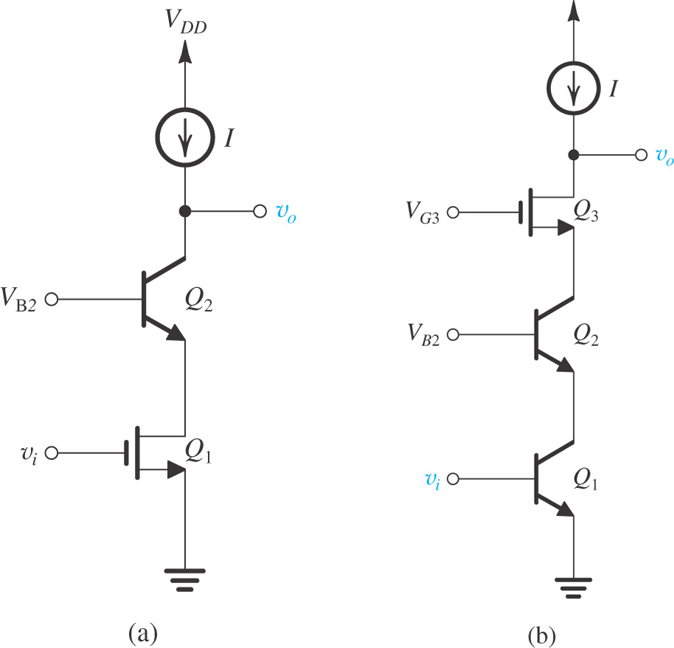
Figure shows two possible BiCMOS cascode amplifiers.
The circuit in Figure uses a MOS transistor for the amplifying device and a BJT for the cascode device.
The advantage of this circuit is an infinite input resistance as compared with all BJT case.
Figure BiCMOS cascodes.

Slide 92
Problem Example

Slide 93
Q1. Figure shows a PMOS CS stage using an NMOS current source load. Compute the voltage gain of the circuit

Slide 94

CS Stage with Diode-Connected Load
In some applications, we may use diode-connected MOSFET as the drain load as shown in the figure below, such a topology exhibits only moderate gain due to the relatively low impedance of the diode-connected device. Assuming λ=0 , M2 acts as a small-signal resistance equal to $1/{g_{m2}}$

Slide 98
7.4. IC Biasing – Current Sources, Current Mirrors, and Current-Steering Circuits
Biasing in integrated-circuit design is based on the use of constant-current sources.
On an IC chip with a number of amplifier stages, a constant dc current (reference current) is generated at one location and is then replicated at various other locations for biasing.
This is known as current steering.
This approach has the advantage that the effort expended on generating a predictable and stable reference current need not be repeated.

Slide 99

A current mirror would mirror current flowing into the left channel , into the right channel

Slide 100
Concept of Current Mirror
The motivation behind a current mirror is to sense the current from a “golden current source” and duplicate this “golden current” to other locations.

Slide 101
MOS Current Mirror
The same concept of current mirror can be applied to MOS transistors as well.

Slide 102
Concept of mirroring

Slide 103
The current mirrors uses the principle that if the gate –source potential of two identical MOS transistors are equal then the current flown through their Drain terminals should be the same
NMOS current mirrors are used as current sinks and PMOS current mirrors are used as current sources
There is variety of current mirror circuits available, each of them having their own advantages and applications

Slide 104
7.4.1. The Basic MOSFET Current Source
Circuit for a basic MOSFET constant-current source. For proper operation, the output terminal, that is, the drain of Q₂, must be connected to a circuit that ensures that Q₂ operates in saturation.
Basic MOSFET current mirror.

Slide 105
7.4.1. The Basic MOSFET Current Source

Slide 106
Bad MOS Current Mirror Example
This is not a current mirror since the relationship between V_{X} and I_{REF} is not clearly defined.
The only way to clearly define V_{X} with I_{REF} is to use a diode-connected MOS since it provides square-law I-V relationship.

Slide 107
Example: Current Scaling
Similar to their bipolar counterpart, MOS current mirrors can also scale I_{REF} up or down (I₁ = 0.2mA, I₂ = 0.5mA).

